Slide 1
Why Hyper Sprints?
Helping to Build Pods Agility for Supply Chain Modernization

Slide 2


The Opportunity to Reimagine
“Agile enablement through Supply Chain Modernization is an opportunity to reimagine how we work and respond to customer expectations to deliver core products and services”
- Austin Welsh
2

Slide 3
Hyper Sprints Values & Benefits
Hyper Sprints Values
Hyper Sprints Benefits
Hyper Sprints is a new and exciting framework to start an agile transformation within your organization. The items on the right have value, but Hyper Sprints value items on the left more:
Transformation that Sticks
Drive real behavior change to increase the value of the firm through the application of adult and immersive learning science.
Value through Doing
Identify and remove bottlenecks by delivering actual work, seeking understanding and solutions early, and reducing risk of culture change burnout.
Speed to Value
Value delivered more quickly by activating teams in the organization, resulting in fast, transparent results seen enterprise-wide.
Focused and Custom Change
Targeted transformation for teams in the organization depending on their needs, skills, and capabilities.
Practice over Training
Experience over Preparation
Experimentation over Rigidity
Accountability over Responsibility

Slide 4
Pod Activation and Hyper Sprints - based on “Dojo” Concept
Dojo / dōjō translates as “place of the Way” in Japanese.
In recent decades, “Dojo” has been adopted by organizations, working groups, and technology development teams all over the world to refer to a place set-aside and dedicated for immersive, experiential learning.
Attributes of Dojo include ….
HIGH ENERGY
The Dojo is a place of high-energy and enthusiasm where learning and achievements are celebrated and fun is expected
SAFE ENVIRONMENT
The Dojo provides a safe environment for teams to experiment new ways of working while maintaining productivity.
REAL WORK
Teams learn new practices while executing their real work.

Slide 5
Pods Activation Sequence at Dell
01. Identify Pod
02. Pre-Bootcamp
(1-2 Weeks)
Select Pod to start Activation
Early success spread by word-of-mouth will create ‘snowball effect’ for future Dojos
Pod orientation
Set expectations
Prepare product backlog
04. Re-Enter Workplace
03. Hyper Sprints
(6 weeks)
Graduation & celebration
(recommended) 1, 3 & 6 month inspect & adapt
Start with Bootcamp: Multi-Day Learning
Hyper Sprints (Scrum Events in 2.5 days)
Coaching and weekly stakeholder updates

Slide 6
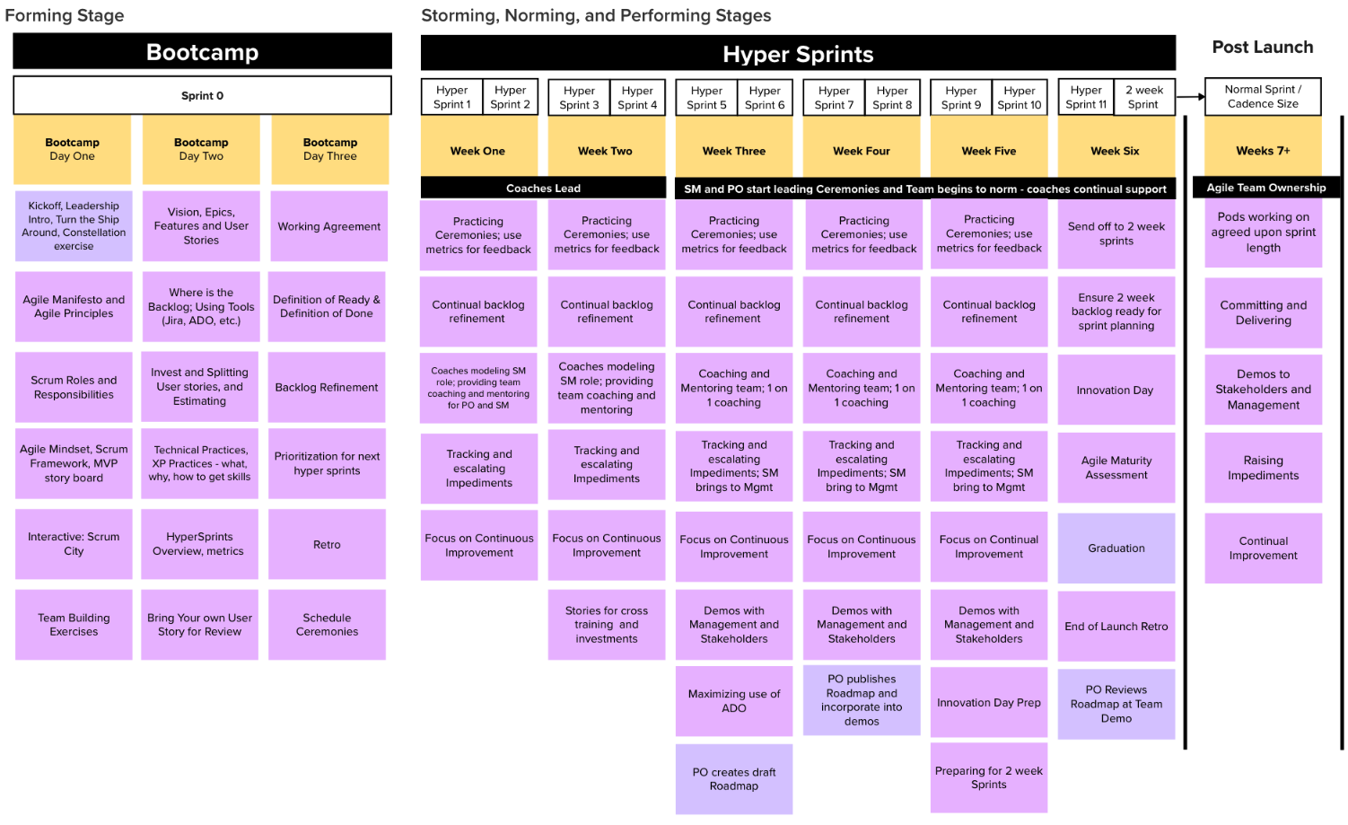
What Does Experiencing a Pod Activation Mean?
This is what the timeline will be like:
A 3-day bootcamp, followed by a 6-week series of Hyper Sprints
You are here
Bootcamp:
6-8 hours from team members
2-3 hours from leadership
Next 5 weeks:
100% of team
2 hours from leadership
6th week and beyond:
100% of team
1 hour per week from leadership
6

Slide 7
Q and A

